Slide 1

The Maze Runner App
Java Web Start Application

Slide 2
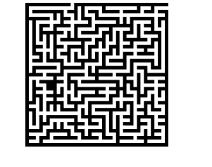
The Project Life Cycle
Convert Pseudo-code to object-oriented programming.
- Algorithm for creating the Maze. - Algorithm for solving the Maze.
Working with Threading and Streams. - Compress and Decompress the Maze. - Server, Client and Multi-Threads.
Desktop app.
- in architecture MVVM - event-oriented programming - GUI

Slide 3
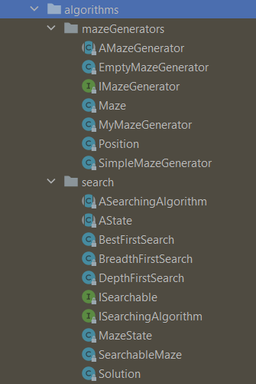

STEP 1
Implementation of algorithms in the first stage :
- Recursive Maze generation
- BFS, DFS and Best First Search

Slide 4
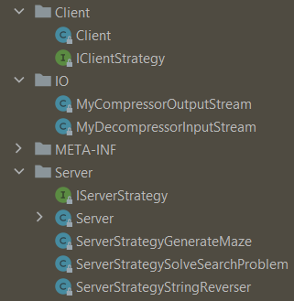
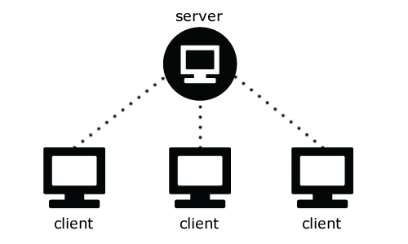
STEP 2
Creating Client, IO Stream and Servers

Slide 5
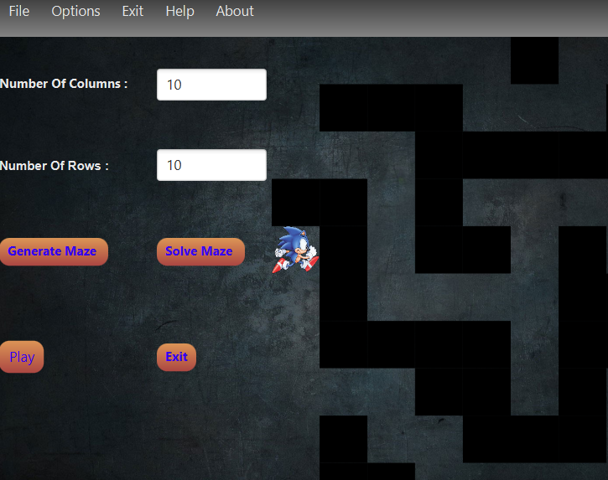
STEP3
MVVM Design Pattern Implementation
Event-oriented programming and GUI

Slide 6
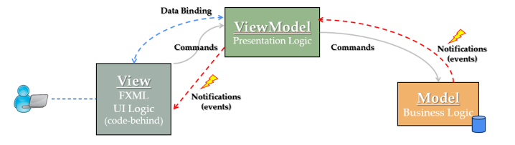
ARCHITECTURE DESIGN
View:
- The Structure - The Layout - The Appearance of what a user sees on the screen
Model : - creating the maze. - solving the maze. - moving the character.

Slide 7
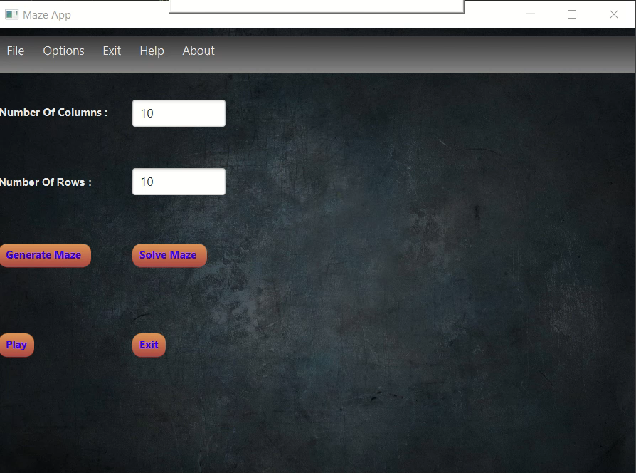
Finally
The Maze Runner App was Done !

